Slide 1
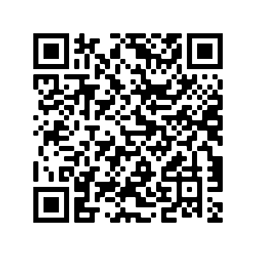
End-to-End IoT
IFTTT + MQTT; Internet-RPi
Steven Knudsen, PhD, Peng
Industrial Professor in Applied Innovation
Department of Electrical and Computer Engg.
Mentor, ICE
knud@ualberta.ca
Innovation, Creativity, and Entrepreneurship (ICE) Incubator

Slide 2
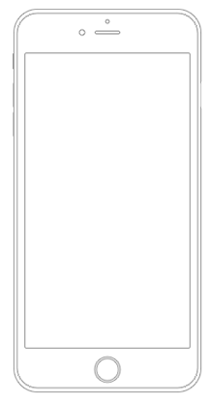



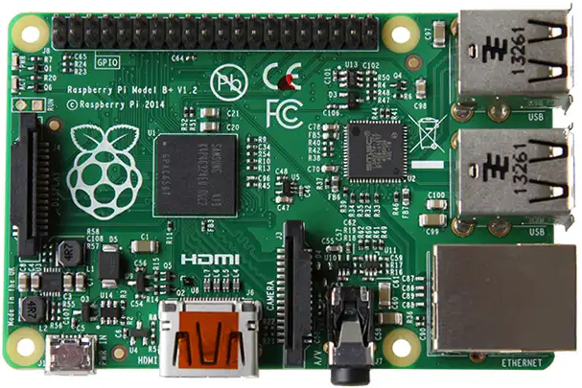

Objective: Tkinter notification triggered.

Slide 3
Overview of Main Steps
Set up MQTT (Adafruit IO)
Set up IFTTT
Confirm RPi can poll MQTT server, get command from IFTTT
Make simple tkinter program that displays a dialog when triggered
Done!

Slide 4

Information and Caveats
Sources
github.com/knud/HackEDbeta2021Workshop
io.adafuit.com - MQTT
ifttt.com – If This Then That (IFTTT)

Slide 5
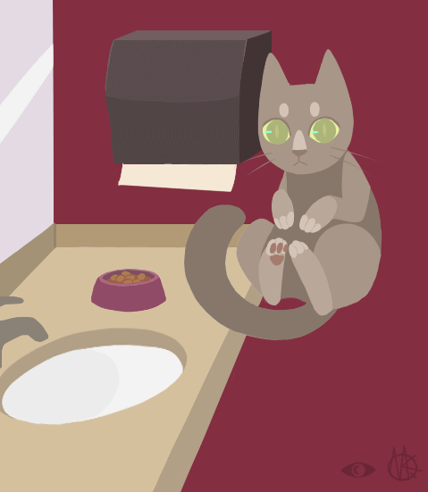
Information and Cavets
Should work at home. Some necessary networking protocols are blocked in places like the U of A
Zero-conf
Multicast DNS (mDNS)

Slide 6
MQTT — mqtt.org
An extremely lightweight publish/subscribe messaging transport to support machine-to-machine (M2M), Internet of Things (IoT) interactions.
Small; Windows executable is 1.4 MB
https://en.wikipedia.org/wiki/MQTT

Slide 7
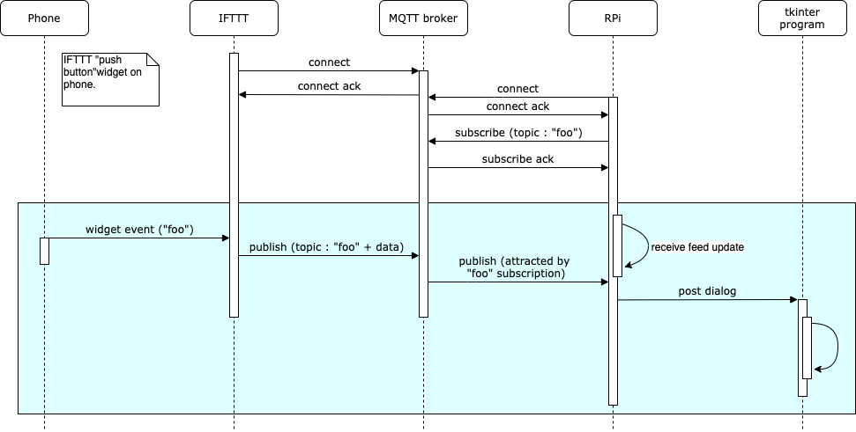
Notes:
IFTTT supports building little apps or applets that will connect your phone or computer to other IoT things.
MQTT is a light-weight publish-subscribe protocol used to connect devices over a network, and most commonly used for IoT applications. We can think of a client server relationship for MQTT-enabled things.

Slide 8
Client
Server
Notes:
The IFTTT service connects to the MQTT broker aka server and will push events to it.

Slide 9
Client
Server
Client
Notes:
The RPi also connects to the MQTT broker and subscribes for events that match what the IFTTT client might push.
If the RPi gets an event it’s looking for, it can do something, like turn on a switch, make a measurement, or in our case display a dialogue

Slide 10
Set up MQTT
Sign up with io.adafruit.com (aka AIO)
Create new dashboard and open
Create a new feed and block
Set up / customize the block
Record AIO key
Needed for IFTTT and RPi client

Slide 11
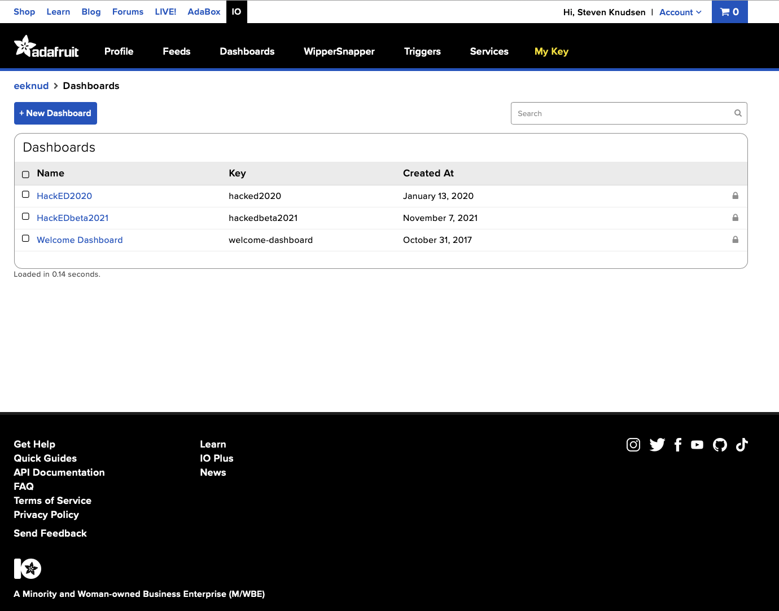
https://io.adafruit.com/eeknud/dashboards
Notes:
After we have signed up for an Adafruit account, go to io.adafruit.com Make a new dashboard.

Slide 12
Notes:
Click on the dashboard name to being creating some actions.

Slide 13
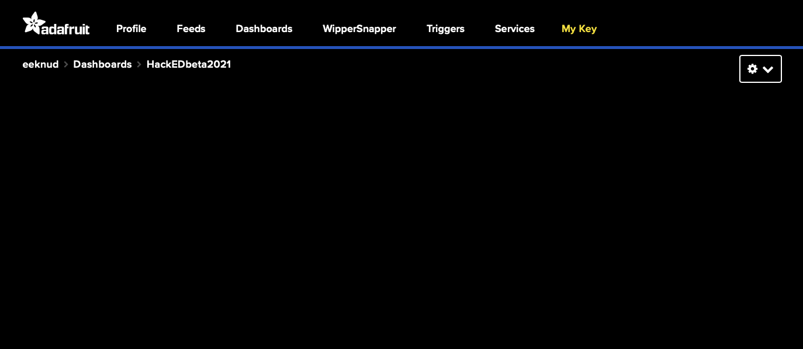
Notes:
Our dashboard is empty,

Slide 14
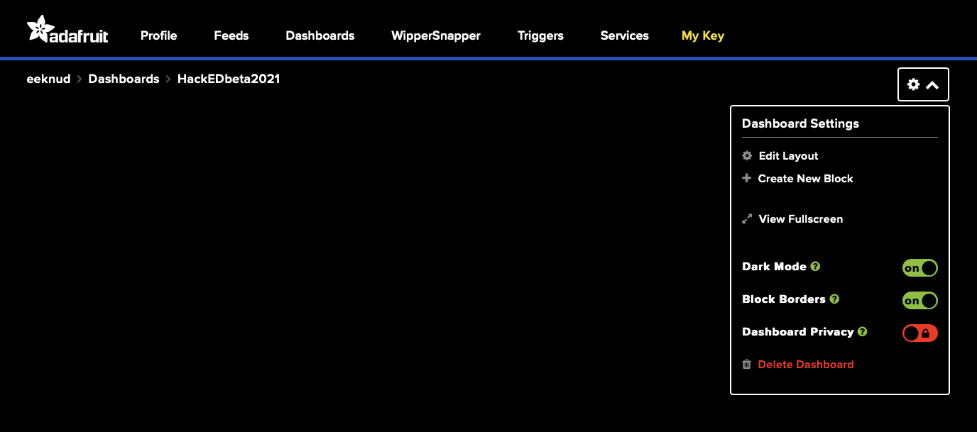

Slide 15
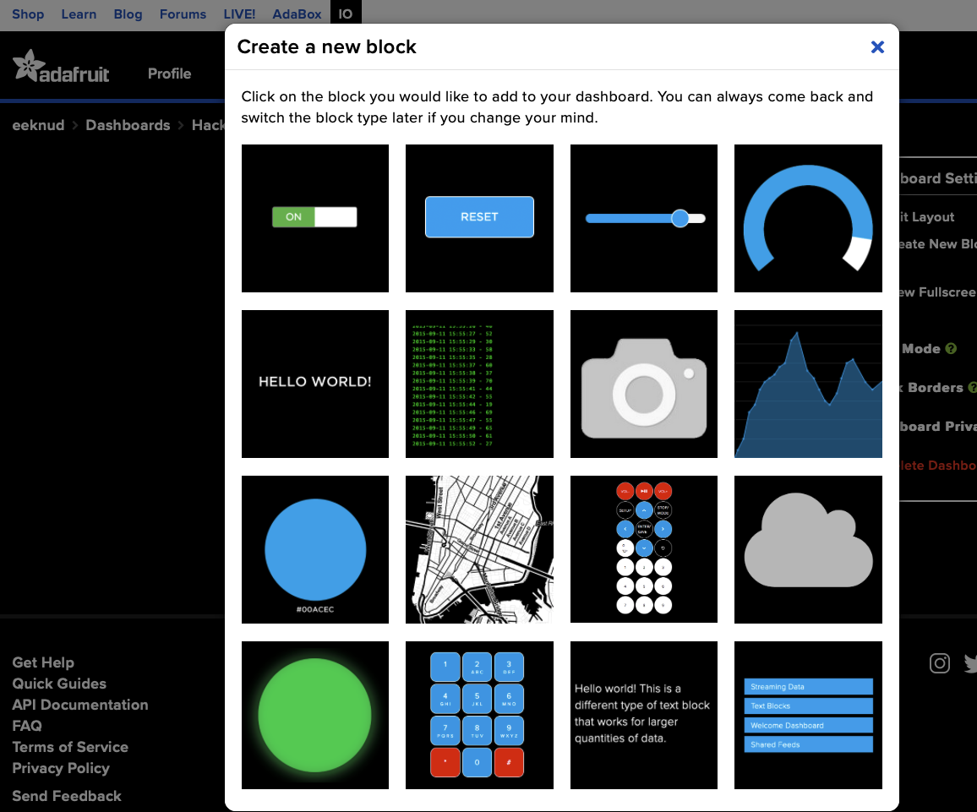

Slide 16
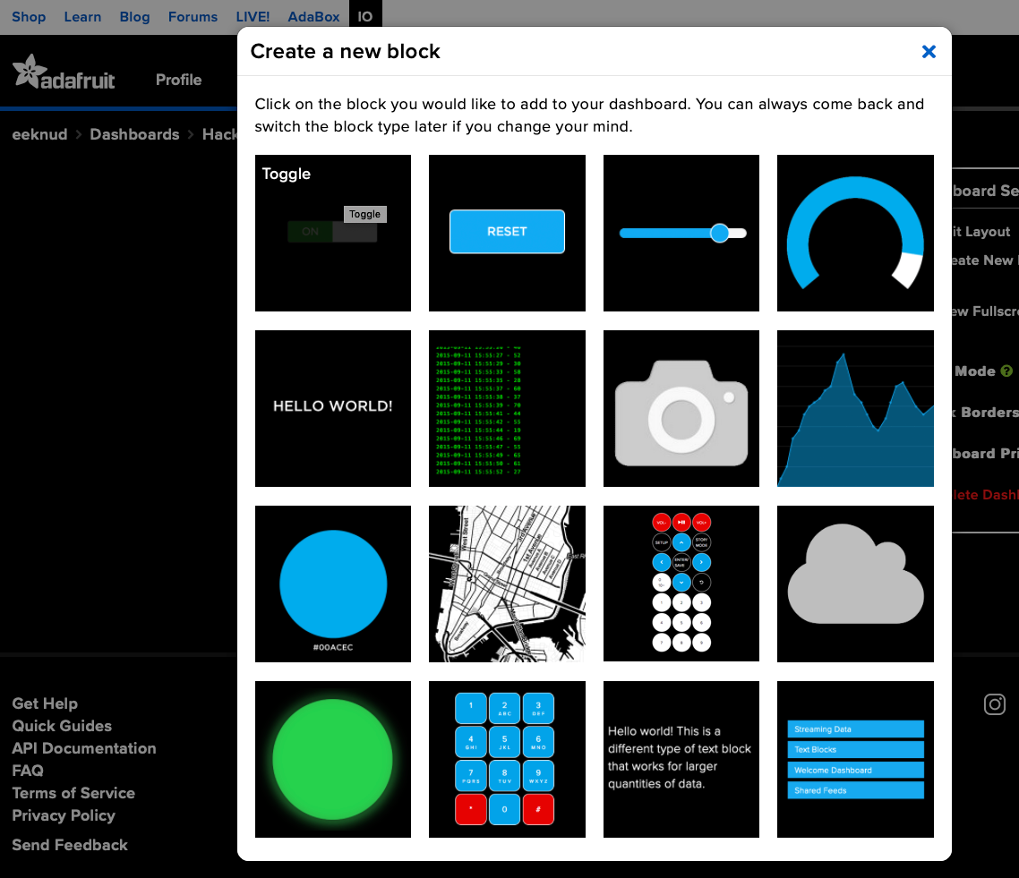
Notes:
Hovering over the switch indicates it’s a toggle switch

Slide 17
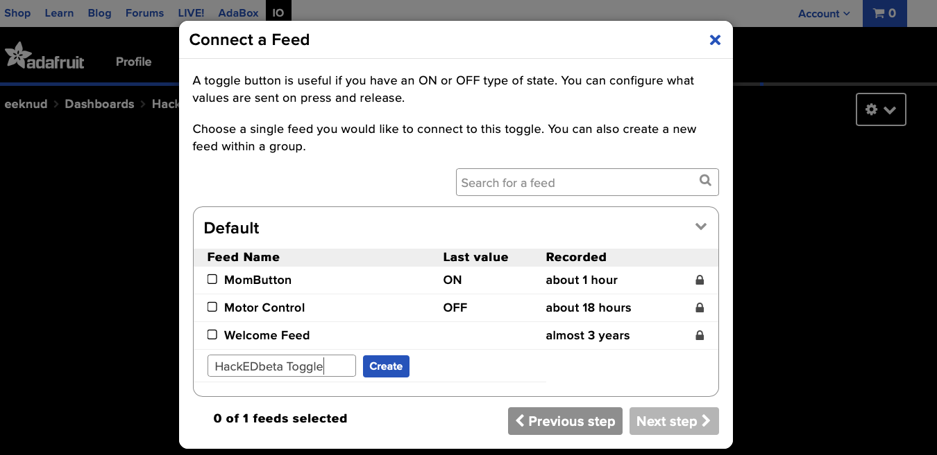
Notes:
Let’s give our feed a good name and create

Slide 18
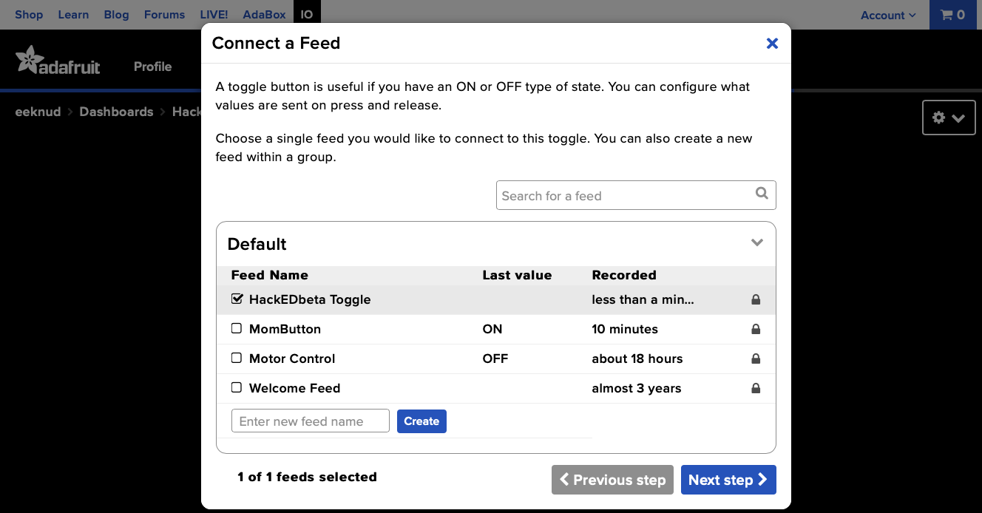
Notes:
Select the feed and go to next step

Slide 19
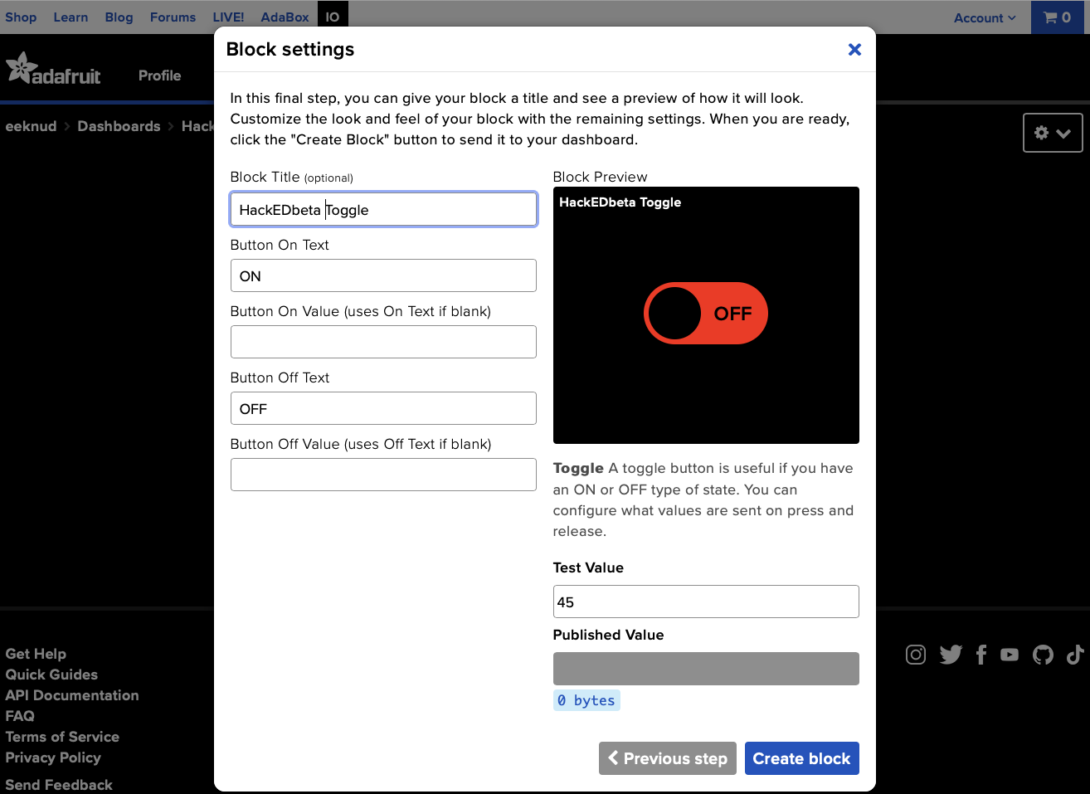
Notes:
We give our toggle switch a nice name. Can leave the rest as is.
We expect to receive a value of either ON or OFF depending on the toggle’s state.

Slide 20
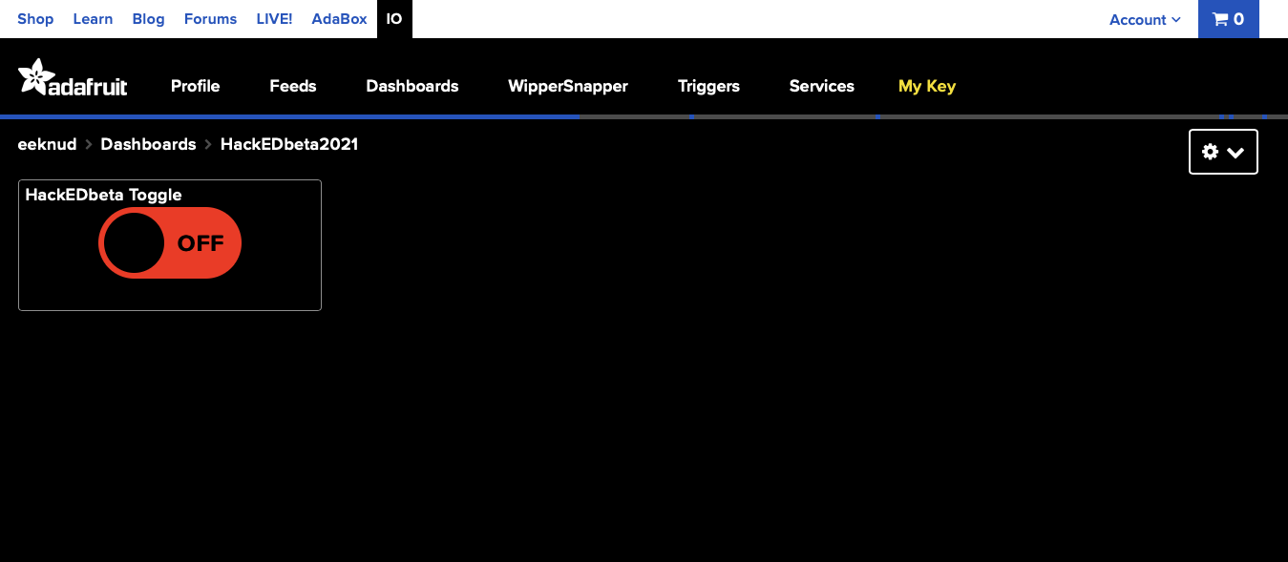
Notes:
This is what our button looks like.
Next we need some key information that we use later as part of our Raspberry Pi program
Click My Key

Slide 21
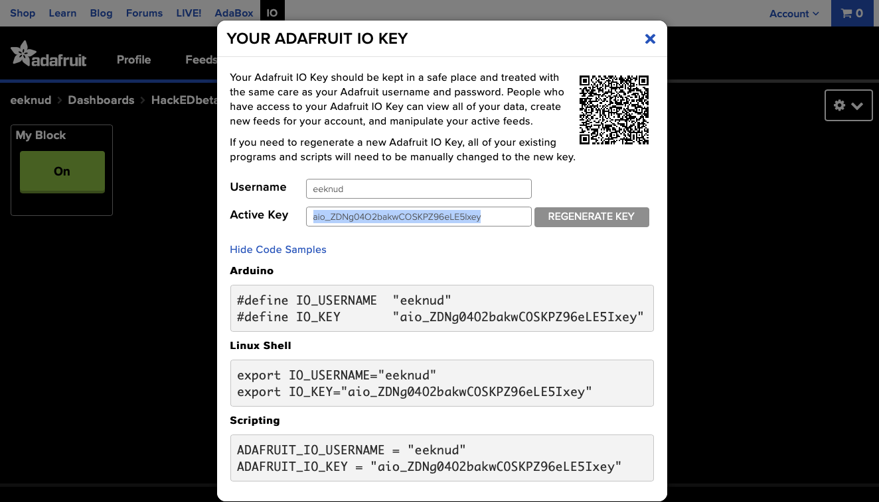
Notes:
We are going to want the username and key information, but are going to use it in a Python program, so it will be declared a little differently.

Slide 22
Next, set up IFTTT
Create a new widget
Select an action (“This”)
Button
Select a service (“That”)
Choose Adafruit service
We’ll make one button to toggle something ON, and another to toggle it OFF

Slide 23
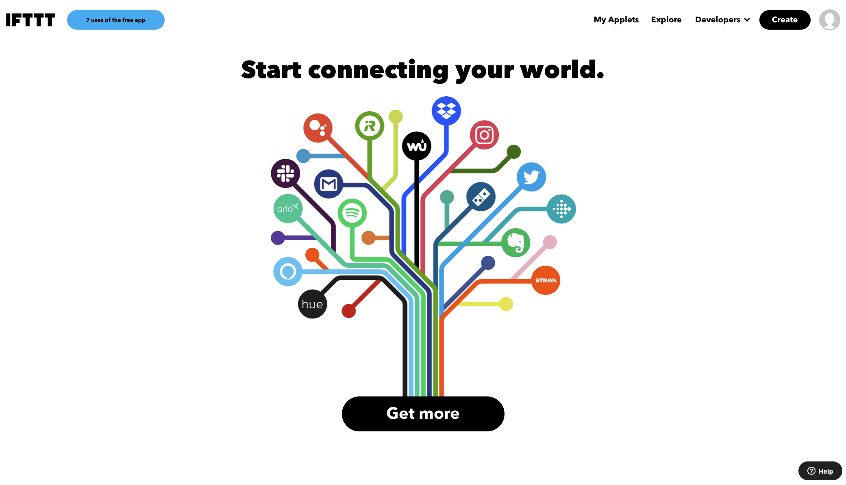
Notes:
When you create an account with IFTTT, you’ll likely see a page like this, which is where we create our first widget
Click Create

Slide 24
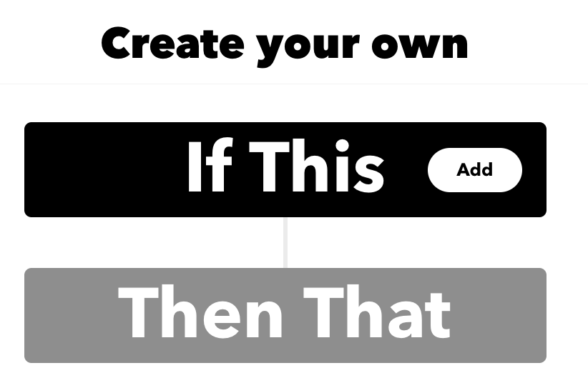

Slide 25
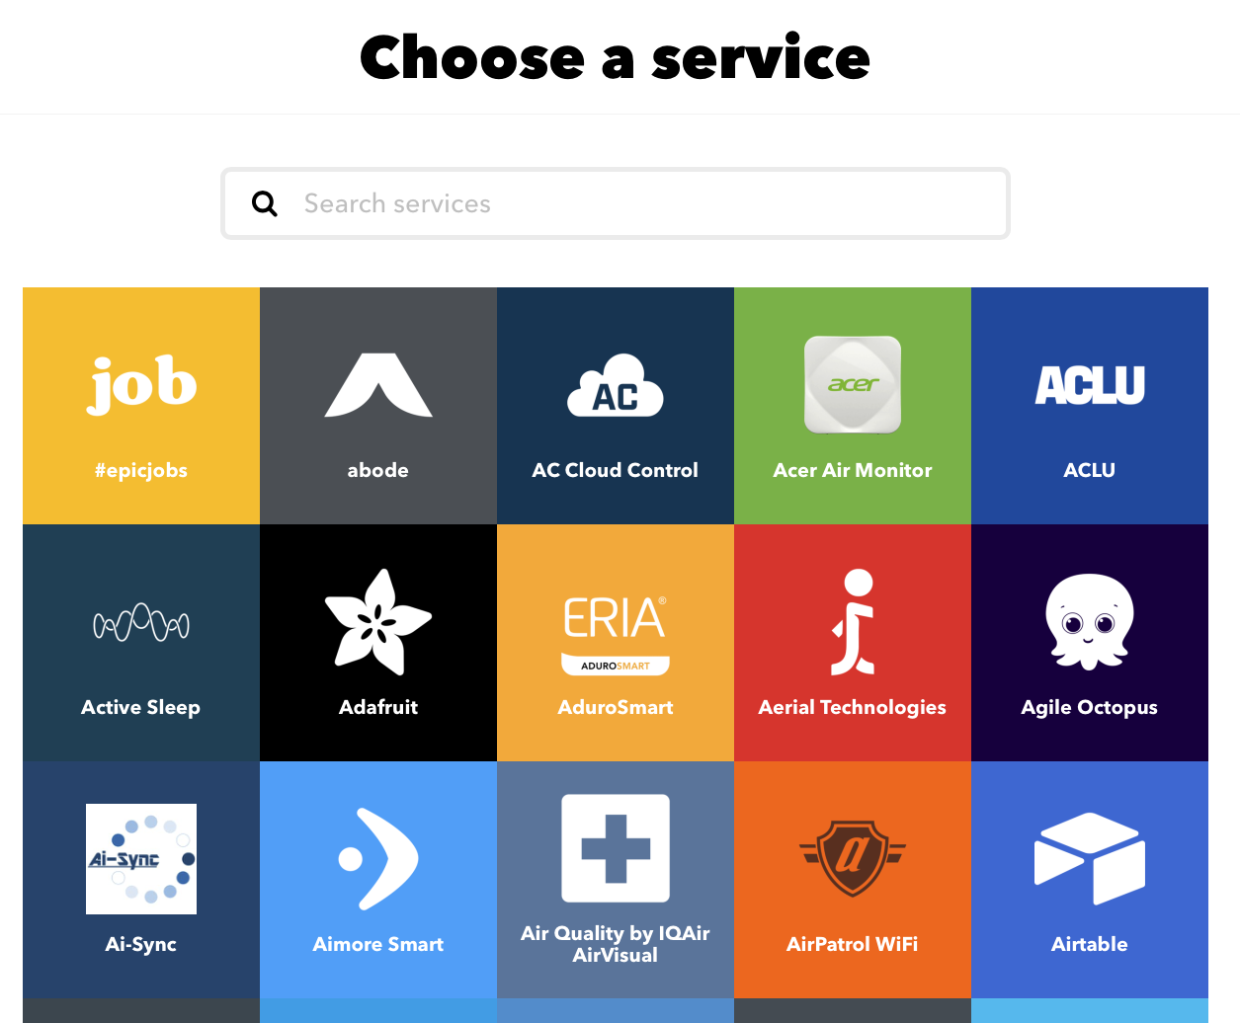
Notes:
We can choose a service
Enter “button”

Slide 26
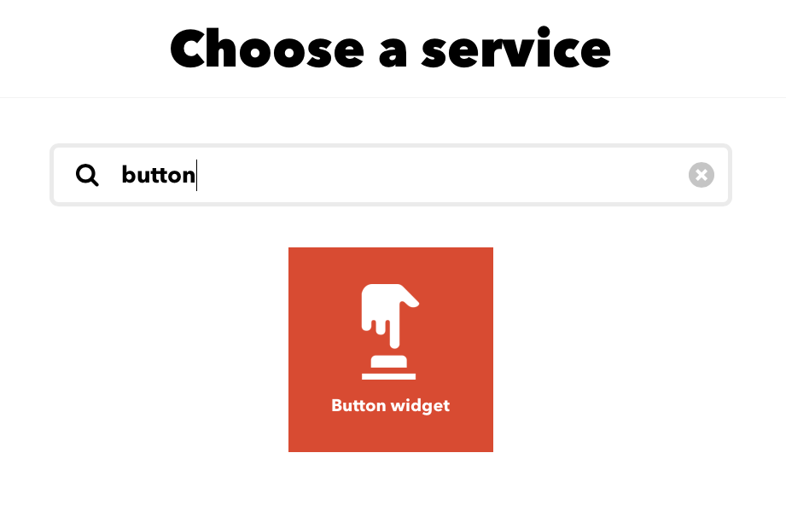
Notes:
Click the button

Slide 27
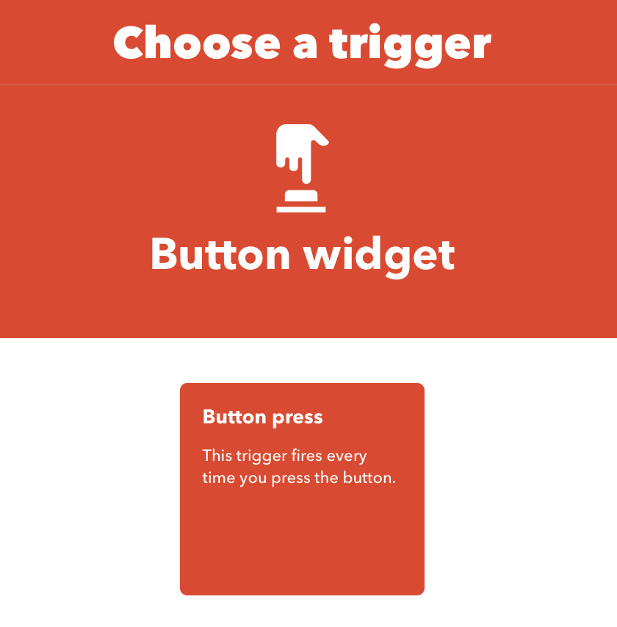
Notes:
There is only one trigger

Slide 28
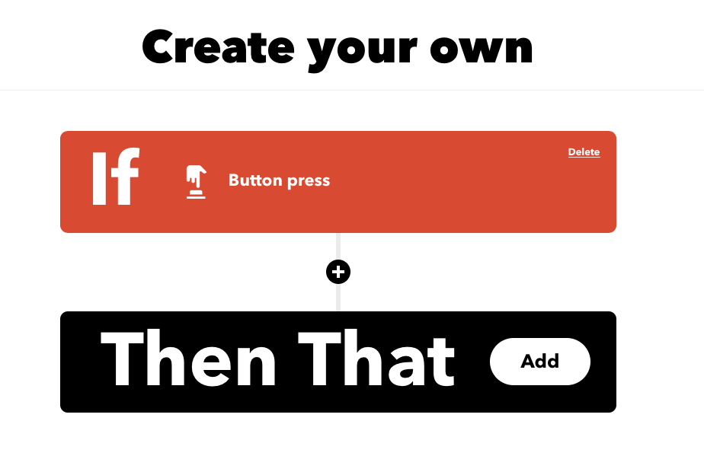
Notes:
Now we add what should happen when the button is pressed
Click Add

Slide 29
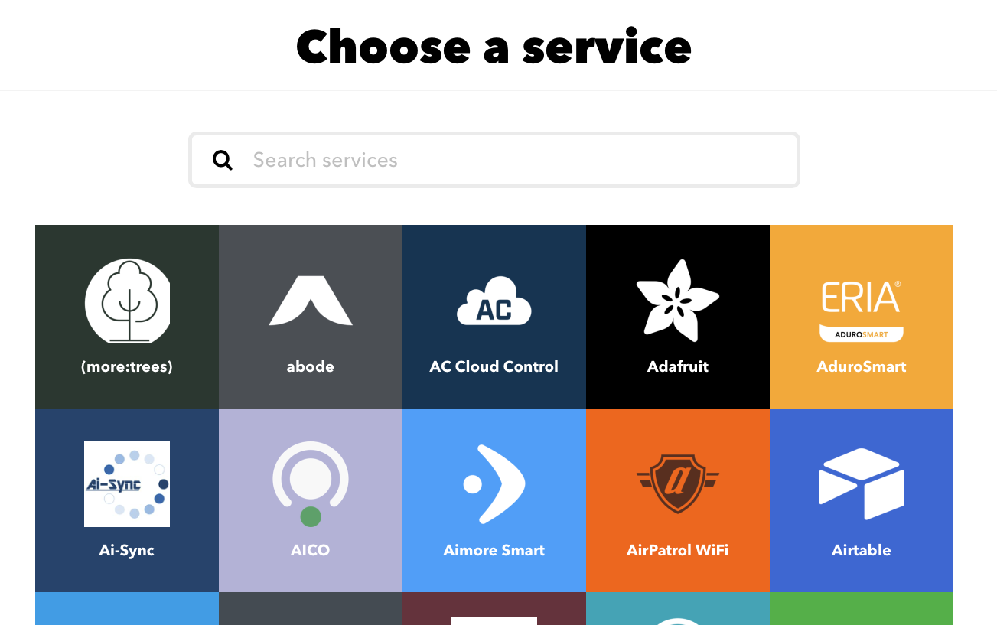
Notes:
There are many services, but it happens that the one we want is near the top.
Choose Adafuit

Slide 30
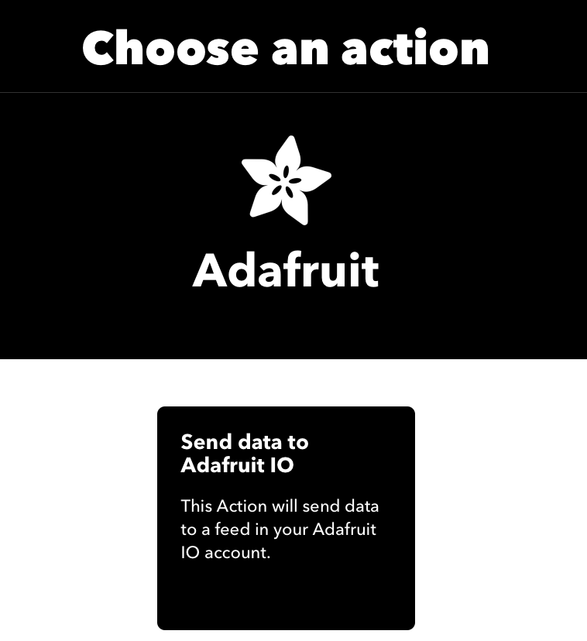
Notes:
Similar to before, there is only one choice here, so click Send data to Adafruit IO.
In other IFTTT actions there can be more…

Slide 31
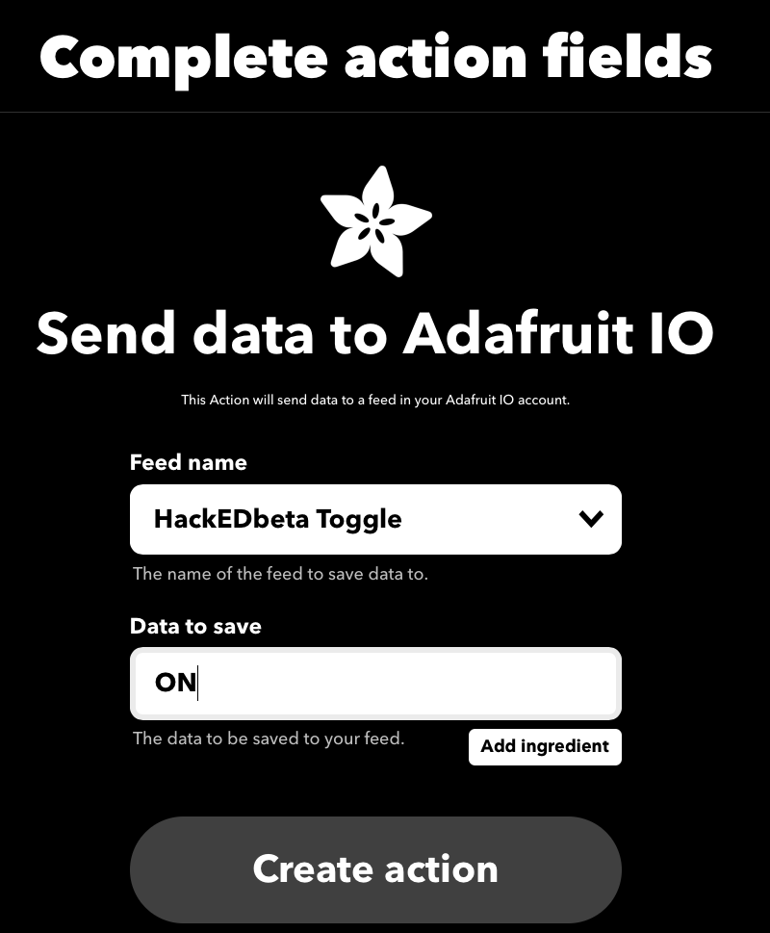
Notes:
I had already connected my Adafruit account as a service in IFTTT, so the feed name we set up, HackEDbeta Toggle is available.
We can put anything for the data to save, but we’d like to differentiate one button push from another so we can switch things on and off
Click Create action

Slide 32
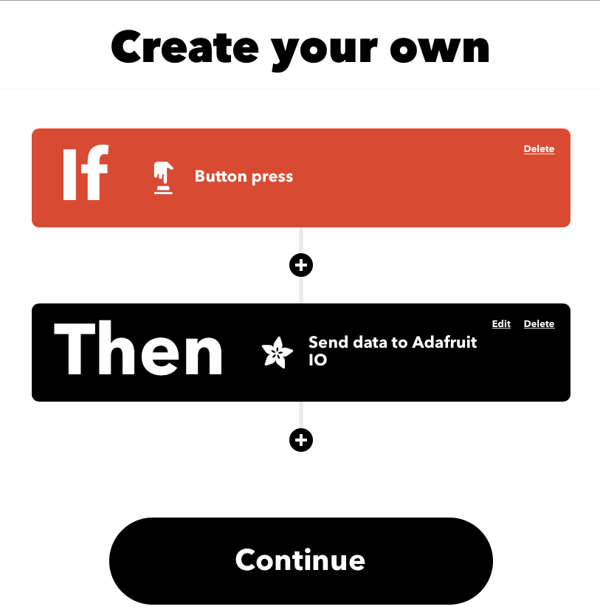

Slide 33
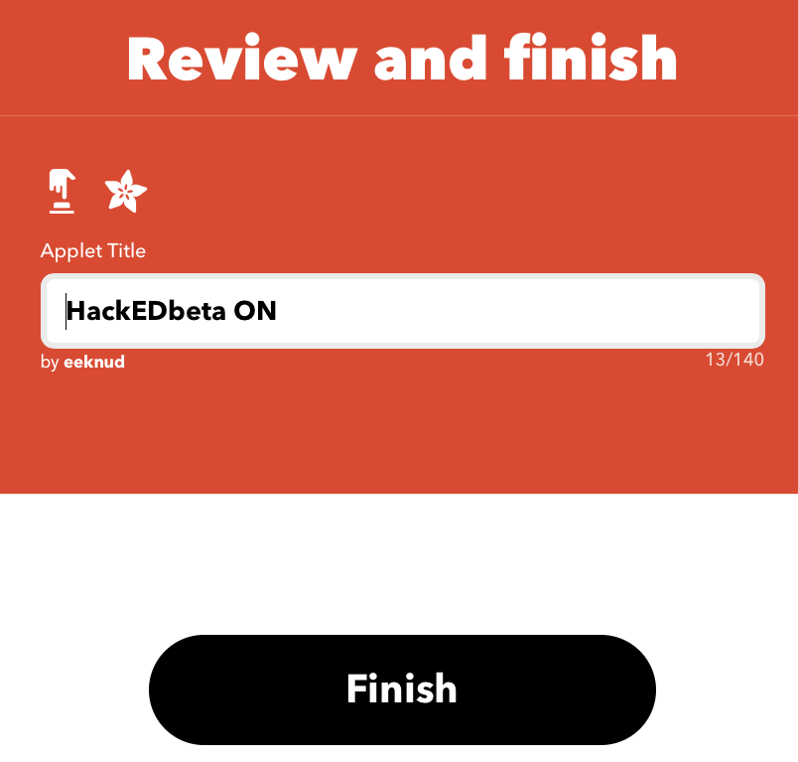
Notes:
Our widget is finished, so click Finish

Slide 34
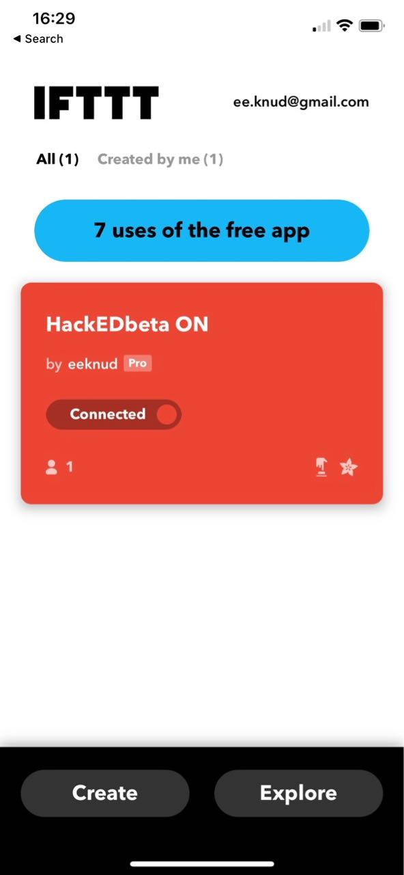
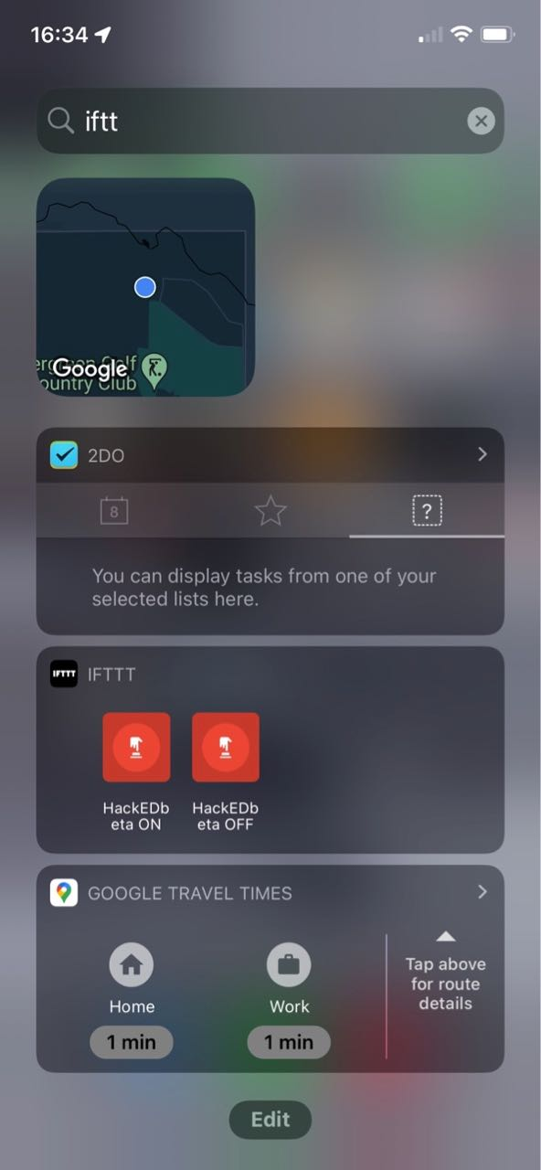
Notes:
Pretty soon the new widget shows up on my iPhone IFTTT app
If I swipe right, I can see that the widget shows up on the screen. I can tap it to send a message to the MQTT broker, essentially that I’ve pressed the momentary button
<switch to live MQTT and show action received in real time>

Slide 35
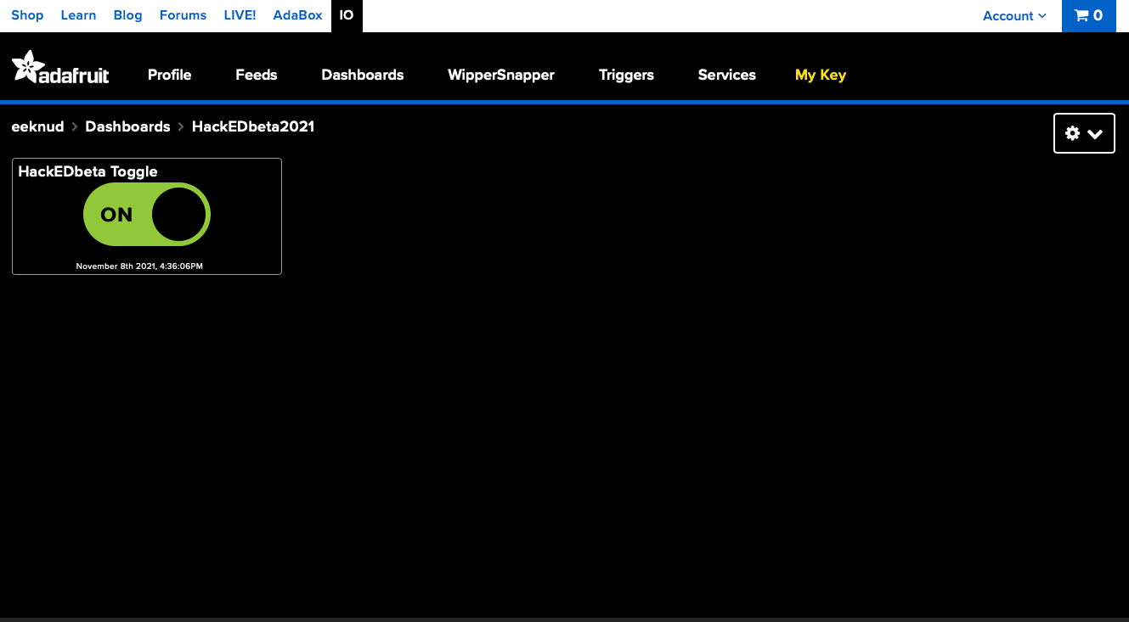

Slide 36
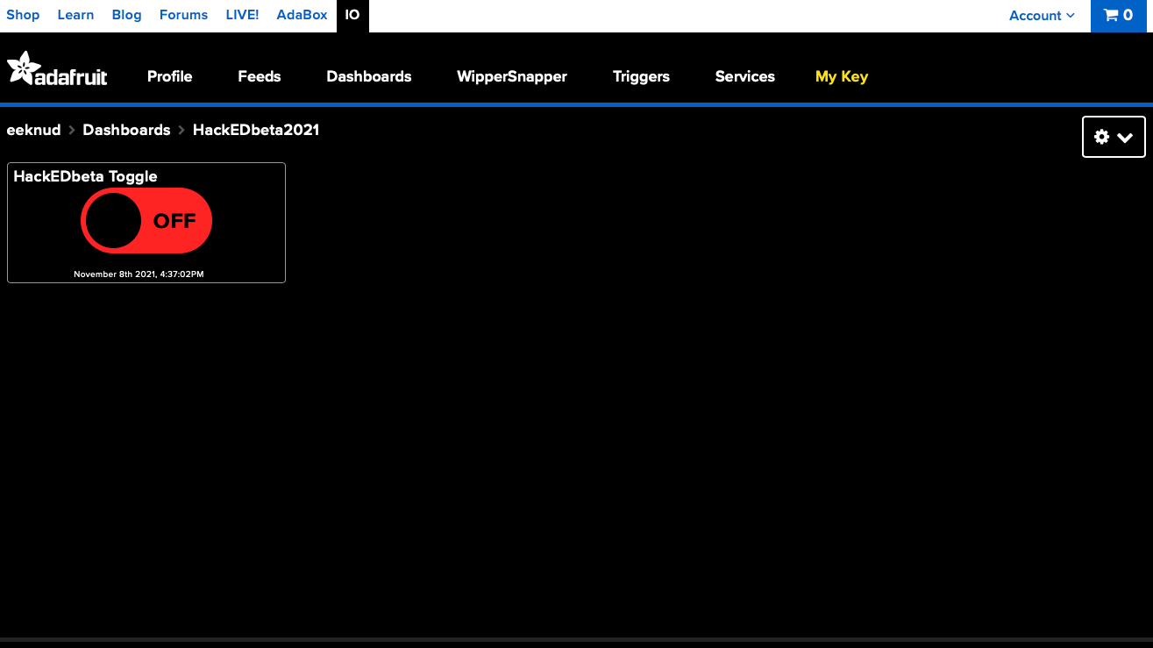

Slide 37
So far...
At this point the IFTTT ON and OFF widgets should activate and be available on your phone
BTW, you need an IFTTT account and their app
Activating the widget sends the data you specified to the Adafruit feed
The Adafruit MQTT broker makes note of it for any subscribers
But we need a subscriber...

Slide 38
Raspberry Pi
Need to be sure that requests, and adafruit-io are installed.
sudo pip3 install requests
sudo pip3 install adafruit-io
Need MQTTRelay.py from github.com/knud/HackEDbeta2021Workshop
MQTTRelay
Connects to Adafruit.io MQTT server
Looks for changes to the last posted message (ON or OFF)
Notifies the user via the command line and a simple Tkinter window

Slide 39
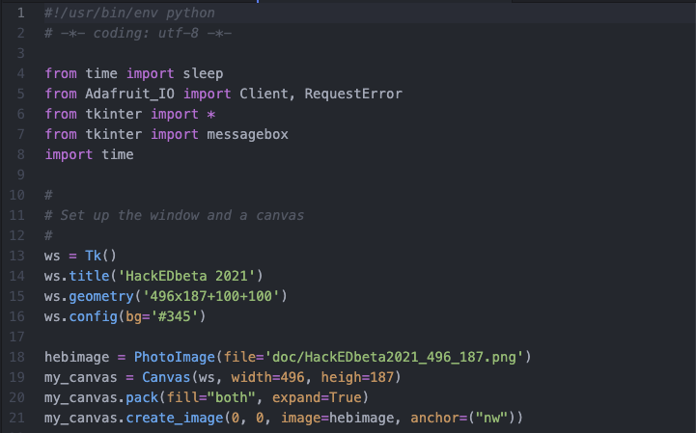
Notes:
In the first part of the Python program we just import what is needed and set up the Tkinter window used to show the status of the received message
That is, the button push from the phone widgets

Slide 40
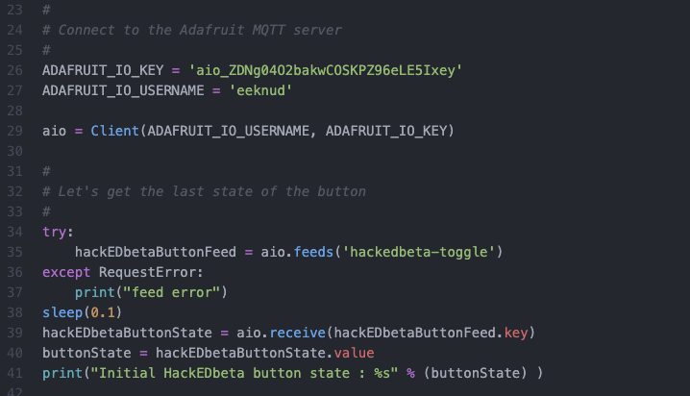
Notes:
Next we define the credentials from Adafruit.io, which we saved in an earlier step
We use them to connect to Adafruit.io and get the initial stat of the button feed data

Slide 41
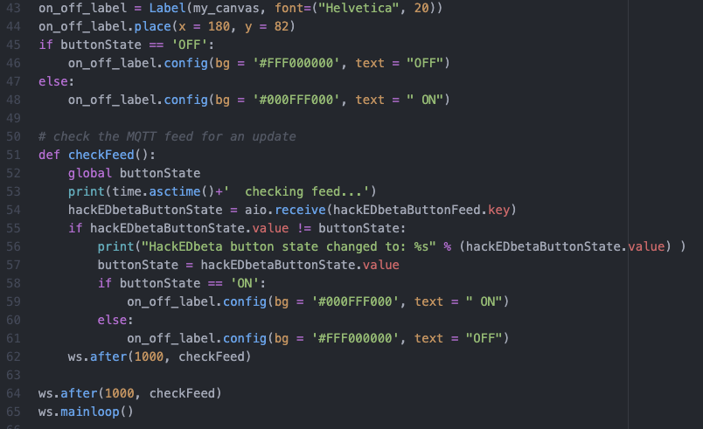
Notes:
The last thing we do is to define a simple Tkinter label we can use to show the change in button state
It will show either ON or OFF.
The checkFeed task is used to check the state of the feed every second, as can be seen in the “after” function.

Slide 42
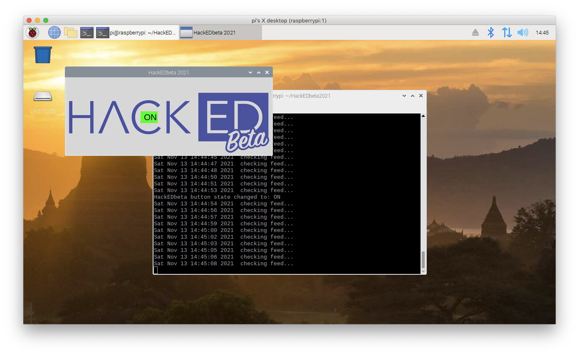
Notes:
When we run the MQTTRelay.py program from the command line, we’ll see something like this.
Let’ try and do a live run

Slide 43
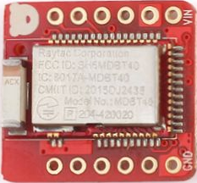
Objective: Control a BLE-enabled device from your phone

